Slide 1
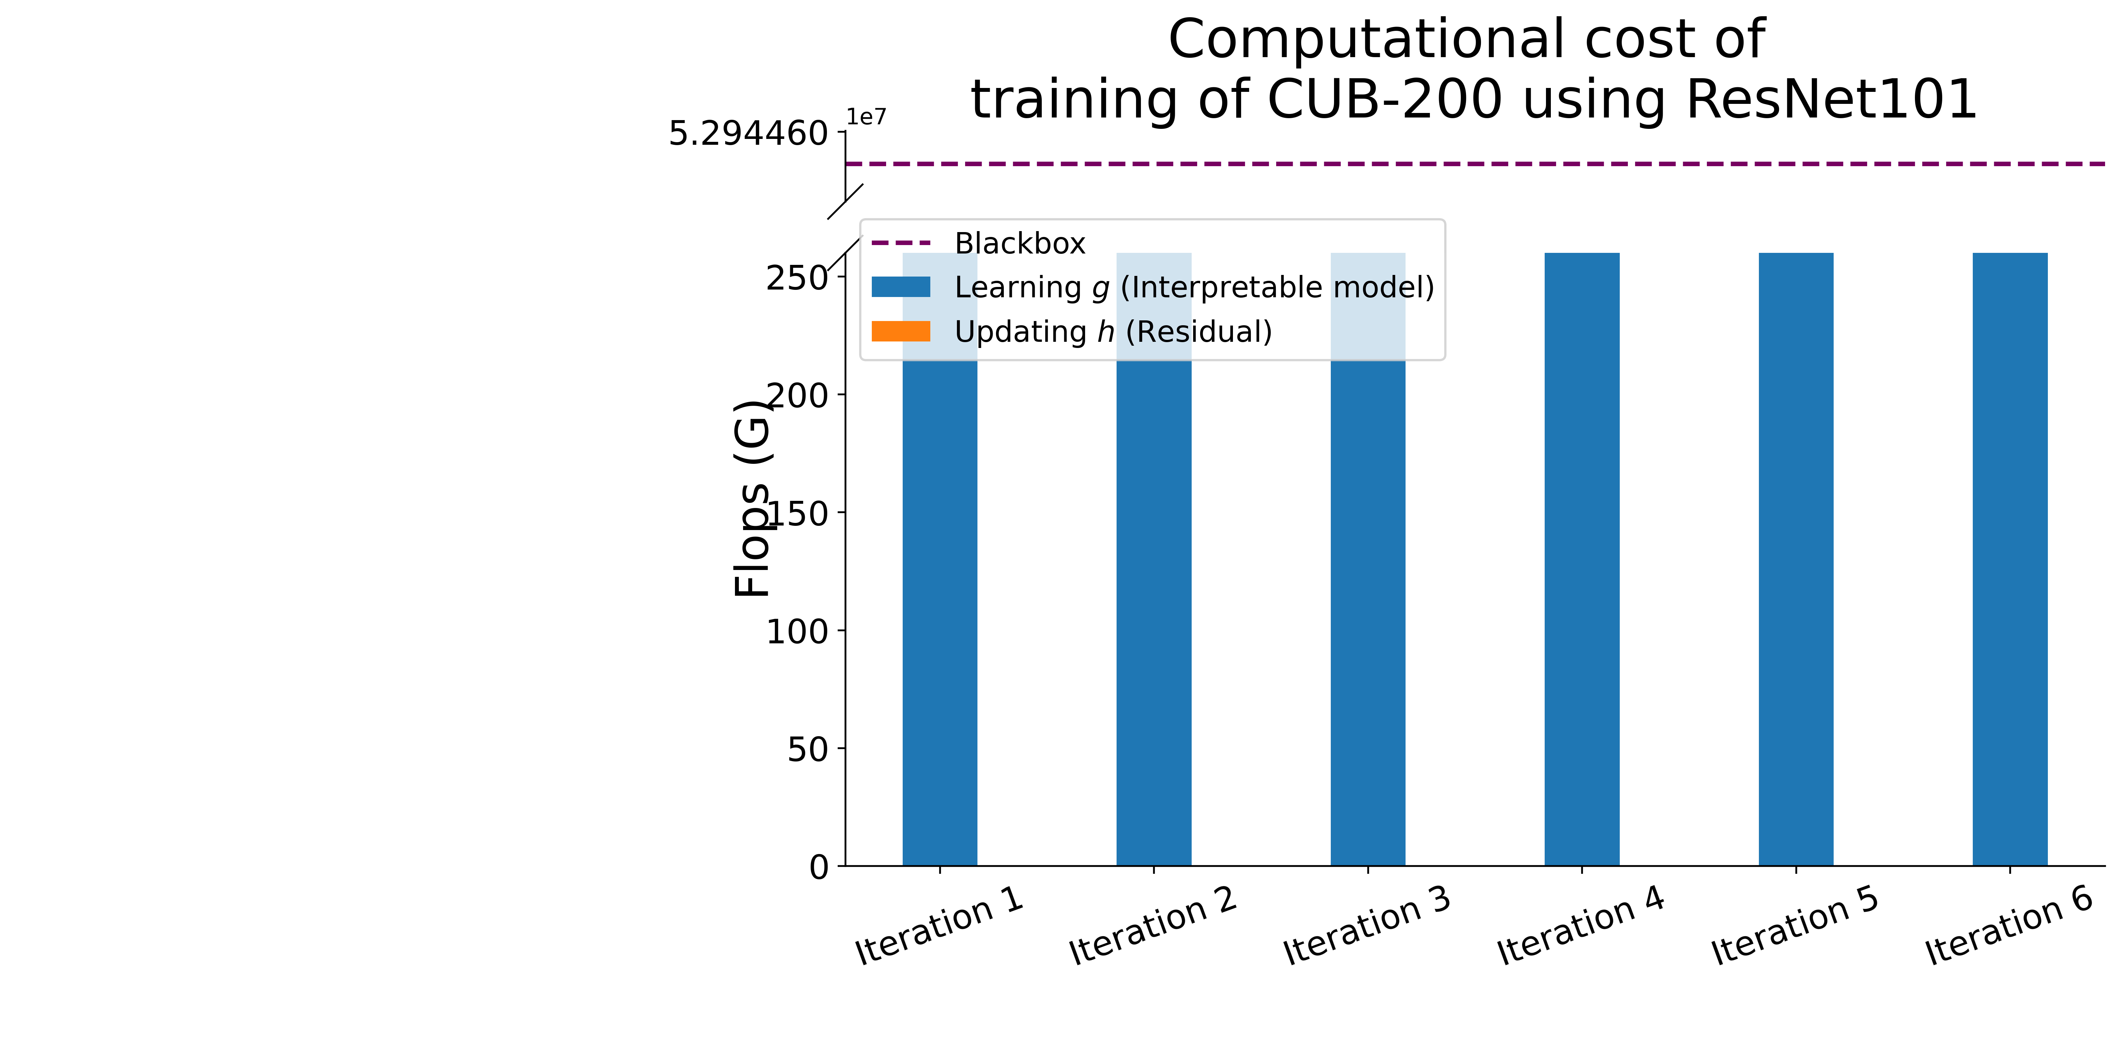
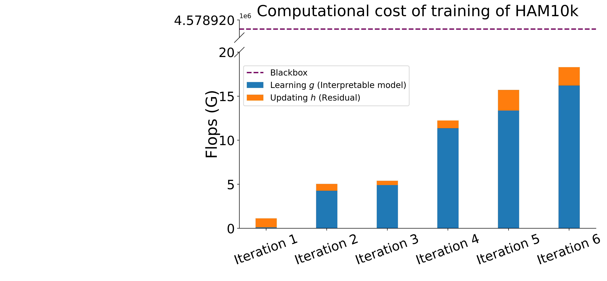
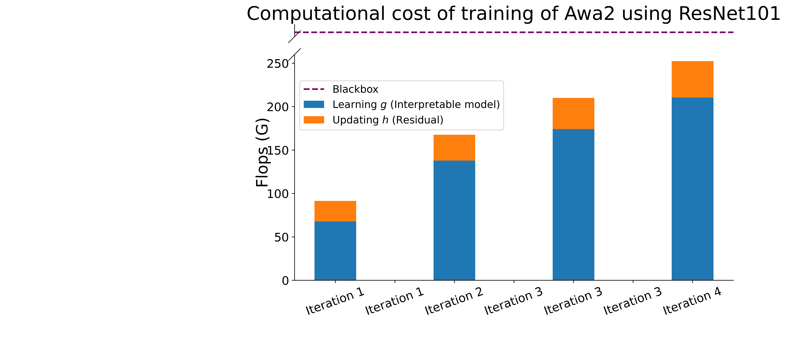

Slide 2
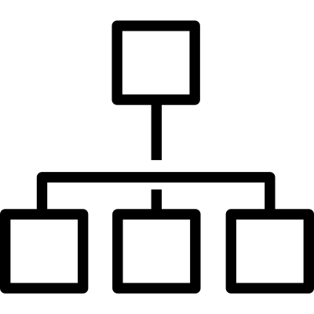
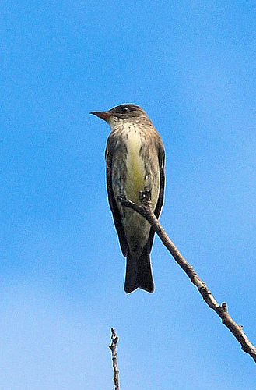
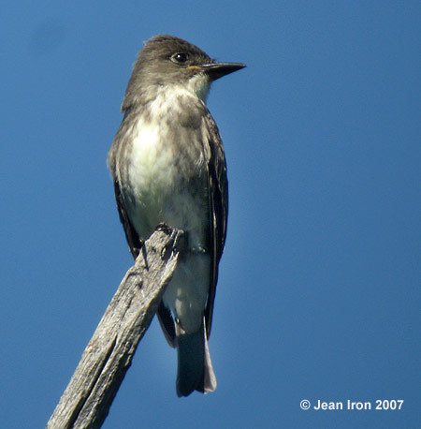
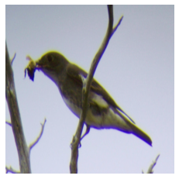
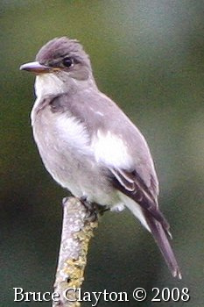
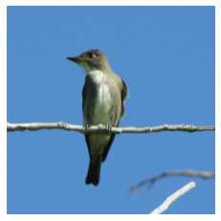
Expert1
MoIE
CBM
+
E-LEN
Expert4
Expert6
(a)
PCBM + E-LEN
Final residual (Unexplained)
(b)
(c)
Notes:
&\textbf{Olive sided Flycatcher} \leftrightarrow \text{underparts\_color\_grey} \land \\
&\text{wing\_color\_grey} \land \neg\text{belly\_pattern\_solid} \land \\
& \neg\text{breast\_pattern\_solid} \land \neg\text{wing\_shape\_roundedwings}
\textbf{Olive sided Flycatcher} \leftrightarrow & \text{underparts\_color\_grey} \land \\
&\text{wing\_color\_grey}

Slide 3
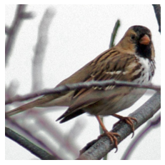
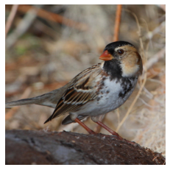
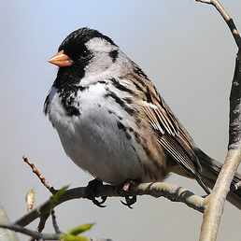
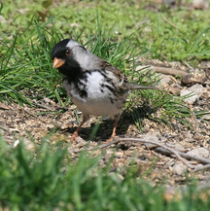
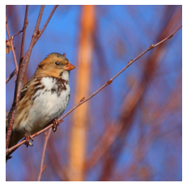
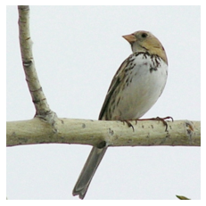
Expert3
Baseline (PCBM + E-LEN)
Baseline (CBM + E-LEN)
Expert4
Expert5
Notes:
\textbf{Harris Sparrow} \leftrightarrow &\big(\text{breast\_color\_black} \land \text{nape\_color\_buff} \land \text{tail\_shape\_notched\_tail} \land \\
&\qquad \qquad \neg \text{bill\_shape\_allpurpose}\big) \lor \\
&\big(\text{breast\_color\_black} \land \text{wing\_color\_black} \land \neg \text{bill\_shape\_allpurpose} \land \\
& \qquad \qquad \neg \text{nape\_color\_buff} \land \neg \text{tail\_shape\_notched\_tail}\big)
\text{\textbf{Harris Sparrow}} \leftrightarrow &\text{back\_pattern\_striped} \land \text{crown\_color\_black} \land \text{forehead\_color\_black} \\
&\land \text{tail\_shape\_notched\_tail} \land \text{upperparts\_color\_white} \land \neg \text{back\_pattern\_solid} \\
&\land \neg \text{head\_pattern\_capped} \land \neg \text{leg\_color\_grey}
\textbf{Harris Sparrow} \leftrightarrow & \big(\text{primary\_color\_white} \land \text{tail\_shape\_notched\_tail} \land \text{upper\_tail\_color\_brown} \land\\
& \qquad \text{upperparts\_color\_white} \land \neg \text{breast\_pattern\_striped} \land \\
& \qquad \neg \text{nape\_color\_brown} \land \neg \text{throat\_color\_white} \land \neg \text{under\_tail\_color\_buff} \land \\
& \qquad \neg \text{under\_tail\_color\_white} \land \neg \text{wing\_pattern\_solid} \big) \lor \\
&\big(\text{belly\_color\_white} \land \text{tail\_shape\_notched\_tail} \land \text{throat\_color\_black} \land \\
& \qquad \text{upper\_tail\_color\_brown} \land \neg \text{breast\_pattern\_striped} \land \\
& \qquad \neg \text{nape\_color\_brown} \land \neg \text{primary\_color\_white} \land \neg \text{throat\_color\_white} \land \\
& \qquad \neg \text{under\_tail\_color\_buff} \land \neg \text{under\_tail\_color\_white} \land \\
& \qquad \neg \text{upperparts\_color\_white} \land \neg \text{wing\_pattern\_solid} \big)
\textbf{Harris Sparrow} \leftrightarrow & \big(\text{primary\_color\_white} \land \text{upperparts\_color\_white} \big) \lor \\
& \big(\text{back\_color\_buff} \land \text{back\_pattern\_striped} \land \\
& \qquad \neg \text{breast\_pattern\_solid} \land \neg \text{forehead\_color\_black} \land \neg \text{nape\_color\_brown} \land \\
& \qquad \neg \text{nape\_color\_buff} \land \neg \text{primary\_color\_white} \land \\
& \qquad \neg \text{throat\_color\_white} \land \neg \text{upperparts\_color\_white} \land \neg \text{wing\_color\_buff} \big) \\
\textbf{Harris Sparrow} \leftrightarrow & \big(\text{breast\_color\_black} \land \text{nape\_color\_buff} \land \text{primary\_color\_white} \land \text{under\_tail\_color\_brown}\big) \\
&\lor \big(\text{breast\_color\_black} \land \text{primary\_color\_white} \land \text{upperparts\_color\_white} \land \\
&\neg \text{nape\_color\_buff} \land \neg \text{under\_tail\_color\_brown}\big)

Slide 4
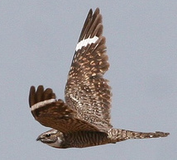
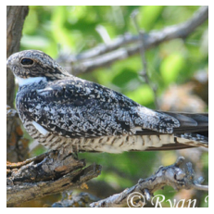
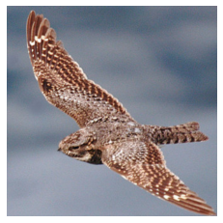
Expert4
Baseline (CBM + E-LEN)
Baseline (PCBM + E-LEN)
Expert5
Notes:
\textbf{Nighthawk} \leftrightarrow & \text{throat\_color\_white} \land \text{wing\_color\_white} \land \\
& \neg \text{shape\_perchinglike} \land \neg \text{underparts\_color\_brown}
\textbf{Nighthawk} \leftrightarrow & \text{throat\_color\_white} \land \text{wing\_color\_white}
\textbf{Nighthawk} \leftrightarrow & \big(\text{bill\_shape\_cone} \land \text{breast\_color\_brown} \land \\
& \neg \text{shape\_perchinglike} \land \\
& \neg \text{underparts\_color\_brown} \big) \lor \big(\text{throat\_color\_white} \land \\
& \text{wing\_color\_white} \land \neg \text{bill\_shape\_cone} \land \\
& \neg \text{breast\_color\_brown} \land \neg \text{shape\_perchinglike} \land \\
& \neg \text{underparts\_color\_brown}\big)

Slide 5
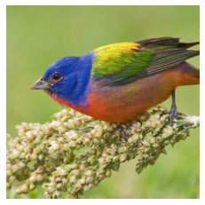
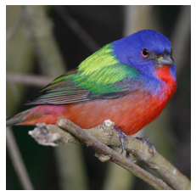
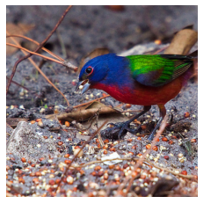
Expert1
Baseline (PCBM + E-LEN)
Baseline (CBM + E-LEN)
Expert2
Notes:
\textbf{Painted Bunting} \leftrightarrow & \text{back\_pattern\_multicolored} \land \text{bill\_shape\_cone} \land \\
& \text{breast\_pattern\_solid} \land \text{eye\_color\_black} \land \text{forehead\_color\_blue} \land \text{leg\_color\_grey} \land \\
& \neg\text{bill\_color\_black} \land \neg\text{bill\_shape\_allpurpose} \land \neg\text{under\_tail\_color\_black} \land \\
& \neg\text{wing\_color\_black} \land \neg\text{wing\_shape\_roundedwings}
\textbf{Painted Bunting} \leftrightarrow & \text{back\_pattern\_multicolored} \\
& \land \text{leg\_color\_grey} \land \\
& \text{wing\_shape\_roundedwings}
\textbf{Painted Bunting} \leftrightarrow & \text{wing\_pattern\_multicolored} \land \\
& \text{bill\_color\_black} \land \\
& \text{wing\_shape\_roundedwings} \land\\
& \text{breast\_pattern\_solid} \land\\
& \text{leg\_color\_grey}

Slide 6
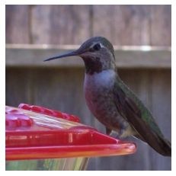
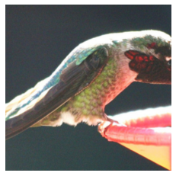
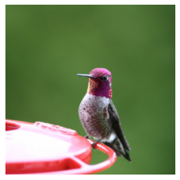
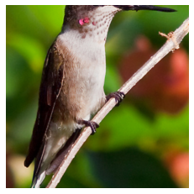
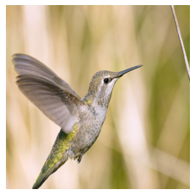
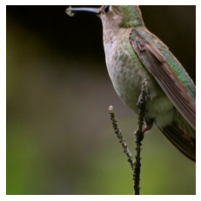
Expert3
Baseline (PCBM + E-LEN)
Baseline (CBM + E-LEN)
Expert5
Residual
Unexplained by a final residual
Notes:
\textbf{Anna Hummingbird} \leftrightarrow &\text{bill\_color\_black} \land \\
& \text{size\_very\_small\_3\_\_5\_in}
\textbf{Anna Hummingbird} \leftrightarrow & \text{leg\_color\_black} \land \\
&\text{size\_very\_small\_3\_5\_in}
\textbf{Anna Hummingbird} \leftrightarrow & \big(\text{size\_very\_small\_3\_5\_in} \land \neg \text{wing\_shape\_roundedwings}\big) \lor \\
&\big(\text{bill\_color\_black} \land \text{eye\_color\_black} \land \neg \text{back\_pattern\_solid} \land \\
&\neg \text{belly\_color\_white} \land \neg \text{wing\_shape\_roundedwings}\big)
\textbf{Anna Hummingbird} \leftrightarrow & \neg\text{nape\_color\_blue}

